Slide 1
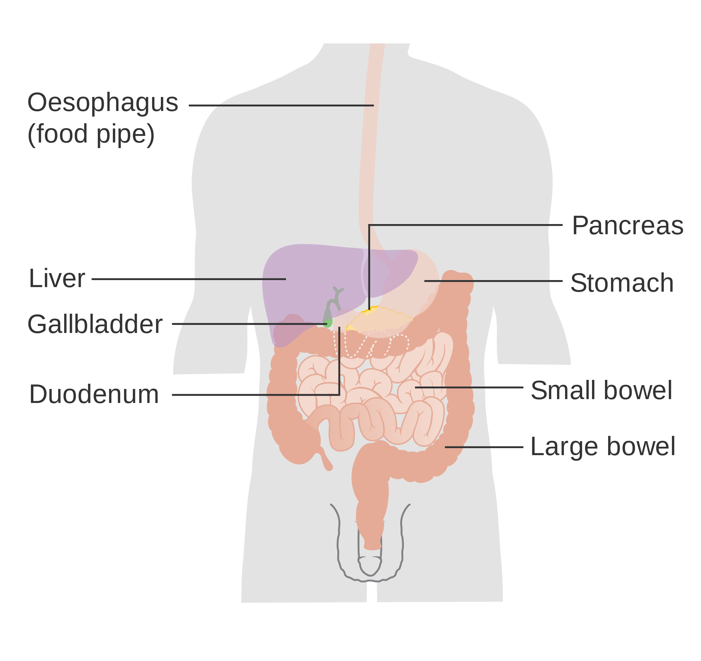
The Digestive System: How it Works
The digestive system is designed to convert the food we eat into nutrients which is used by the body for energy, repairing worn out cells and growth.
Free PPT’s: www.ecosystemforkids.com

Slide 2
The Digestive System: How it Works
Mouth
Food is chewed in the mouth with the help of the teeth. This reduces food into smaller particles and during the process it is mixed with saliva. Saliva also contains a digestive enzyme, amylase, which works on breaking down carbohydrate into starch. Food like bread, potatoes, or pasta, are rich in carbohydrates.
Throat
Food moves from the mouth to the throat (or pharynx) and further to the esophagus.
Esophagus
The esophagus is a muscular tube extending from the throat to the stomach. The lower esophageal sphincter is a valve right where the esophagus meets the stomach. It prevents the backward movement of food.
Stomach
The stomach is a sac-like hollow organ with strong muscular walls. It holds food but also serves as a mixer and grinder. The stomach also secrets acid and enzymes that further breakdown food. The enzyme pepsin is responsible for protein breakdown. This combined action renders food leaving the stomach liquid or paste.
Small intestine
The small intestine is a long tube loosely coiled in the abdomen (it is more than 20 feet long). It is constituted of three segments, the duodenum, jejunum, and ileum. It continues the digestion process using enzymes released by the pancreas and bile from the liver. The duodenum continues the digestive process while the jejunum and ileum absorb minerals. Enzymes secreted by the pancreas break down protein, fat, and carbohydrates.
Pancreas
Liver
Gall bladder
Digestive system
Colon (Large Intestine)
Colon - It is is a 5- to 6-foot-long muscular tube. It is made up of the cecum, the ascending (right) colon, the transverse (across) colon, the descending (left) colon, and the sigmoid colon . Stool, or waste left over from the digestive process is stored here. Bacteria found in the stool also synthesis vitamins.
Rectum
The anus is the last part of the digestive tract. It consists of the pelvic floor muscles and the two anal sphincters which regulate when and how to go to the toilet to evacuate stool or gas.
The rectum (Latin for "straight") is an 8-inch chamber that connects the colon to the anus. The rectum receives stool from the colon and holds it until evacuation.
Anus
Free PPT’s: www.ecosystemforkids.com

Slide 3
www.ecosystemforkids.com
Visit the website above for more free science teaching resources for teachers and parents of students in 1st to 6th grades.
Features Free | PowerPoint Lessons | Worksheets pdf | Online quizzes | Games | Board Games | Card Games | More

